Slide 1
Usable Machine Learning I

Slide 2
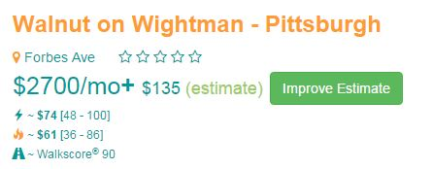

EDigs helps prospective tenants in the rental search process.
Provides users with personalized estimates for utility costs.
If you’re looking for an apartment in Pittsburgh…edigs.org
Also an Android and iPhone app
Notes:
Other features: associate pictures and notes with homes; share notes; filter search by price, size, etc.; include walkscore for homes; ratings for homes; upcoming: city data about building violations

Slide 3
Usable Machine Learning
Difficulties with machine learning
Understand what is going on
Control what is going on
Potential cost to user
Corrections
Features
[Labels]

Slide 4
Understanding what is going on: Forming Mental Models
How does a system know I am addressing it?
How do I know a system is attending to me?
When I issue a command/action, how does the system know what it relates to?
How do I know that the system correctly understands my command and correctly executes my intended action?
Belloti et al., CHI 2002 ‘Making Sense of Sensing’

Slide 5
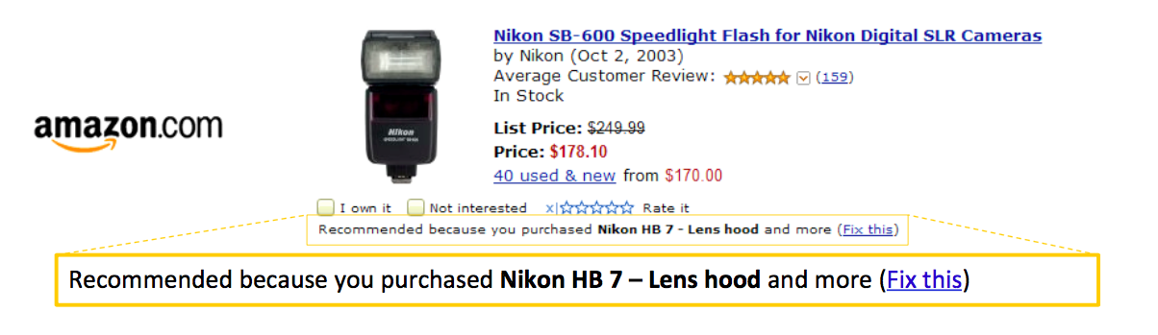
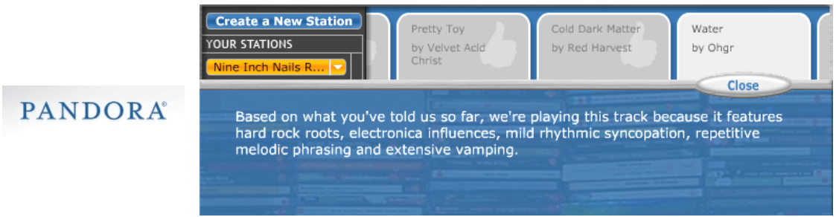
Discuss:
Notes:
How does a system know I am addressing it?
How do I know a system is attending to me?
When I issue a command/action, how does the system know what it relates to?
How do I know that the system correctly understands my command and correctly executes my intended action?
What did the system do?
What if I do W, what will the system do?
Why did the system do X?
Why did the system not do Y
How do I get the system to do Z?

Slide 6
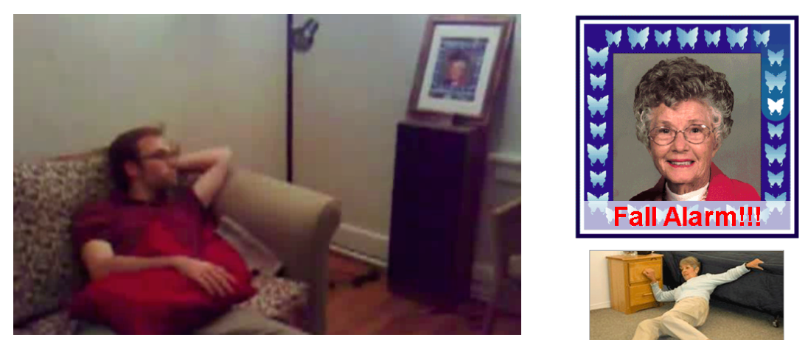
Accident Identification: What would you want to know?
Notes:
Did she fracture any bones in the fall? How long ago did this happen?
If she didn’t fall, How does the system detect falls?

Slide 7
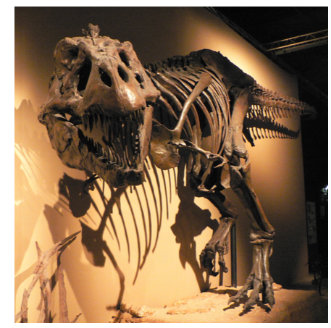
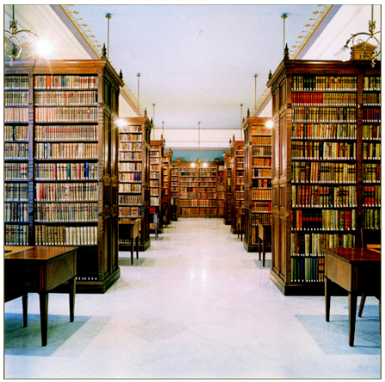
Known Preference

Slide 8
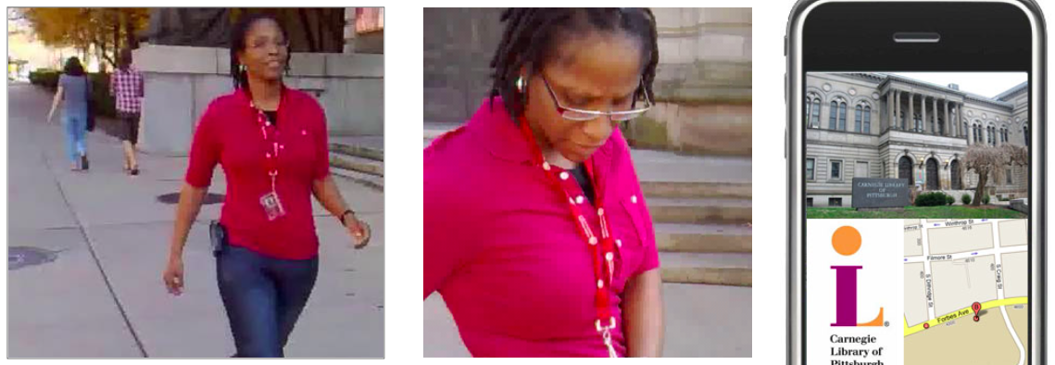
Wrong location-based recommendation
Notes:
Why did it not tell me about the Museum? How does it determine my loca0on?
Providing explana7ons to these ques7ons can make Intelligent systems Intelligible

Slide 9
Types of Feedback
Feedback: crucial to user’s understanding of how a system works and helping guide future action
What did the system do?
What if I do W, what will the system do?
Why did the system do X?
Why did the system not do Y
How do I get the system to do Z?

Slide 10
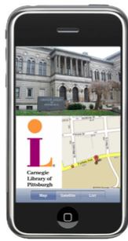
Best Feedback Depends on Circumstance
Did she fracture any bones in the fall?
How long ago did this happen? How does the system detect falls?
Why did it not tell me about the Museum? How does it determine my loca0on?
Notes:
Could add further slides from Dey-intelligibility.pdf
Appropriateness; criticality; goal-supportive; externalities should all be considered in designing for this.

Slide 11
Usable Machine Learning
Difficulties with machine learning
Understand what is going on
Control what is going on [discuss]
Potential cost to user
Corrections
Features
[Labels]

Slide 12
Usable Machine Learning
Difficulties with machine learning
Understand what is going on
Control what is going on [discuss]
Potential cost to user
Corrections
Features
[Labels]

Slide 13
How do people address uncertainty and avoid / correct error?
Contextual Interviews with 7 Practitioners
Interview experts in human direction
Conducted standard interviews and observation of practice, as appropriate
Film & Theatre Directors, Child Photographer
Golf Instructor, Aikido Sensei
911 Phone Operator, Telephone Triage Nurse
Notes:
Wanted to start with systems, but understanding people is equally important….
Reviewed work & interviewed people
Our seven interviewees span a number of disciplines, covering a wide array of direction techniques and domains. In the end, we interviewed [list folks].
performance folks – illicit specific emotional and physical responses.
sports instructors – teach, monitor, and guide new physical actions
Mention telephone operators function over a reduced sensor channel.

Slide 14
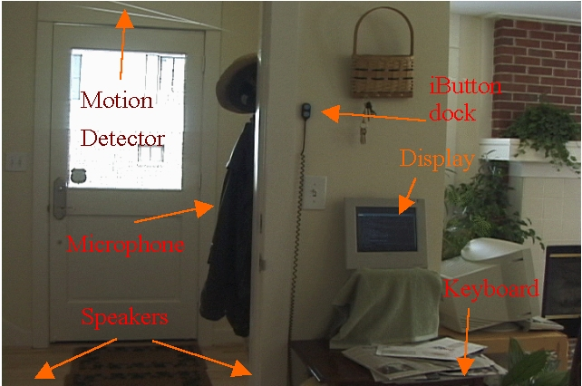
Design Guidelines
How to handle mediation:
Distributed, multi-user settings
Set up interactions across time and space

Slide 15
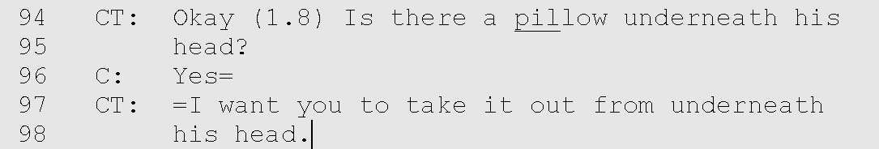
Anticipation
Anticipate common errors before they happen. Actively seek out and address problems before they disrupt interaction.

Slide 16


Anticipation
Anticipate common errors before they happen. Actively seek out and address problems before they disrupt interaction.

Slide 17
Consequences
Explain the consequences, both positive and negative, of particular actions.
Notes:
This allows participants to understand why they are being asked to do particular actions.
Example: Dialog box asking ‘do you really want to delete this file?

Slide 18
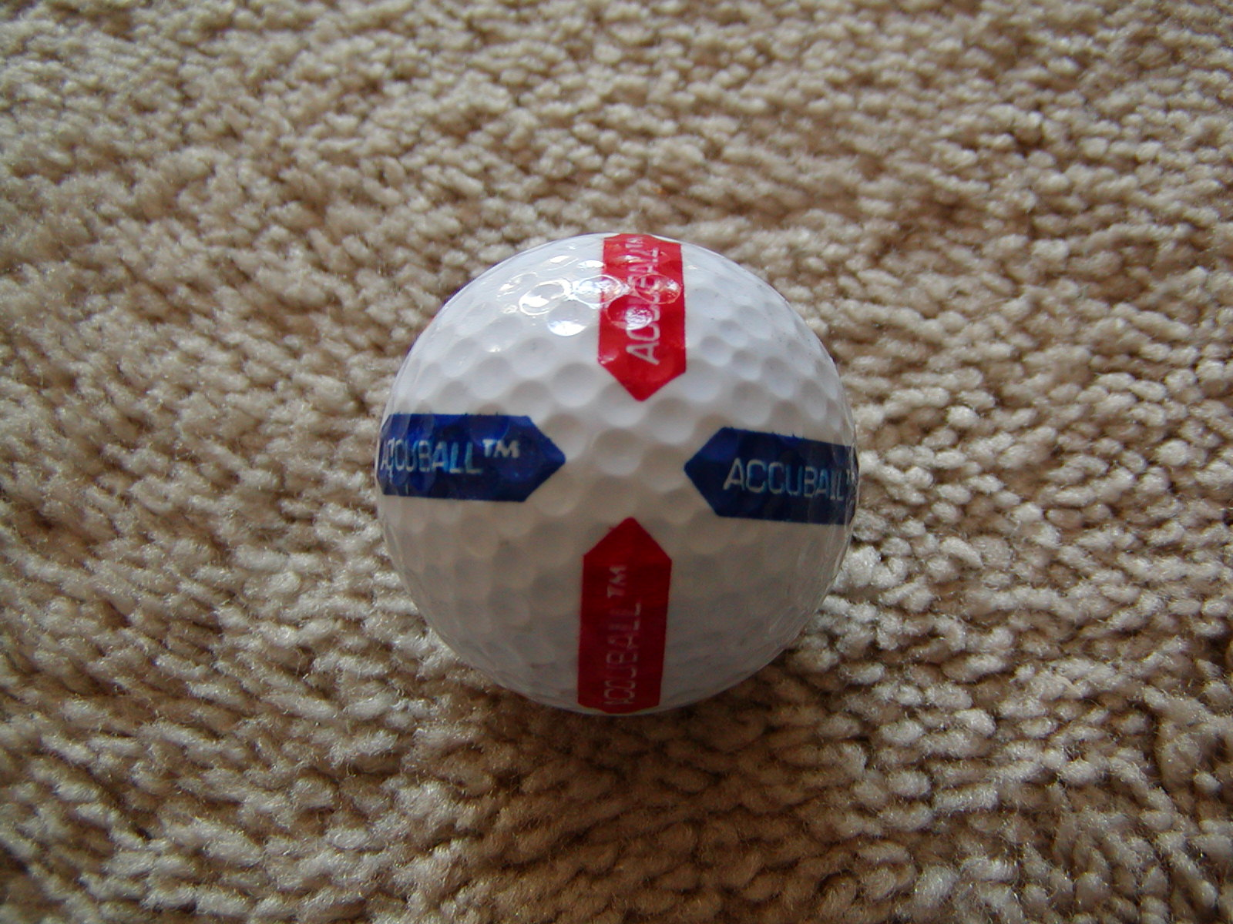
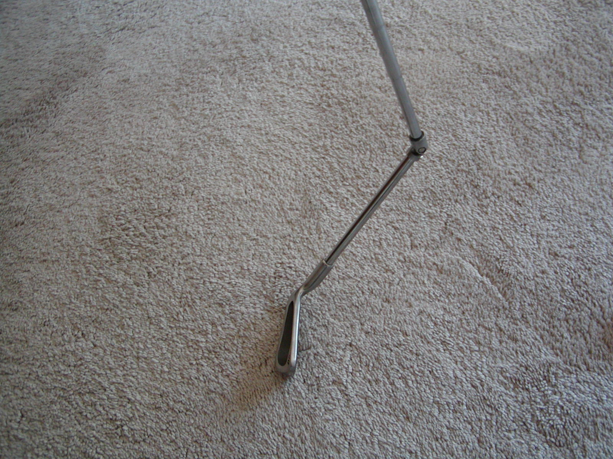
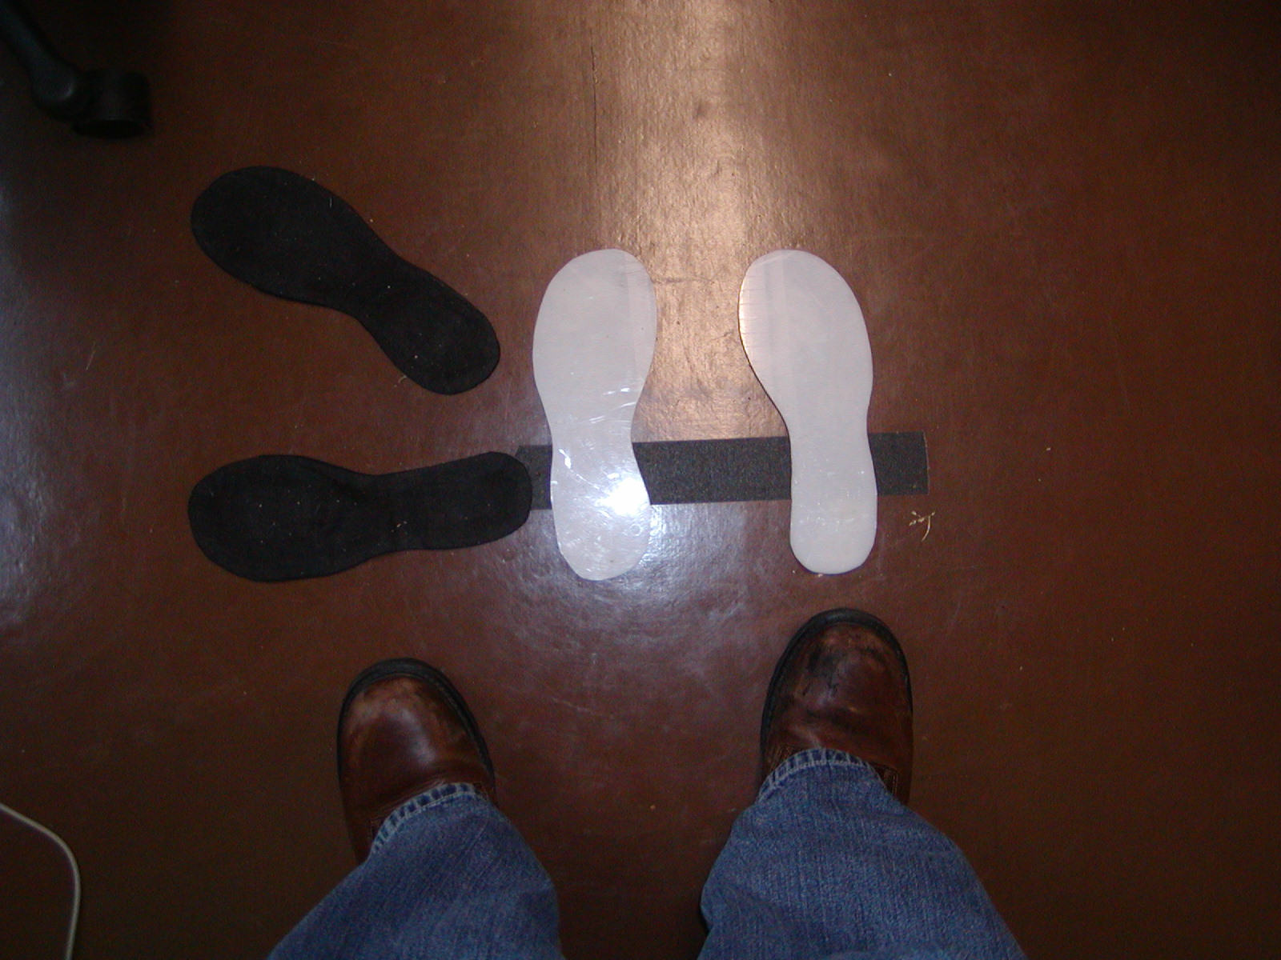
External Aids
Use physical props or other external aids to guide actions and provide feedback.

Slide 19
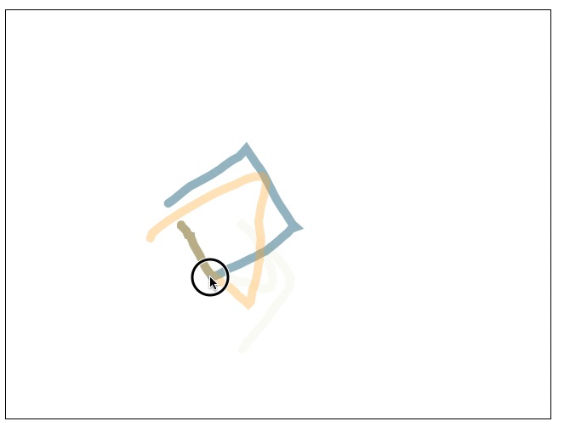
Example: Octopocus [Bau UIST’08]

Slide 20
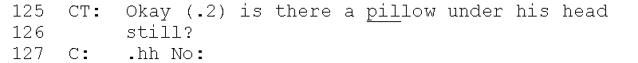
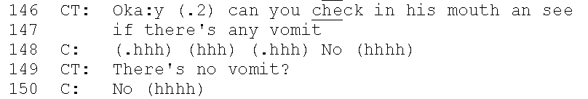
Confirmation
Explicitly query the subject to ensure they are in the expected state.
Notes:
Two reasons to do this
The first reason is to establish grounding. Even a simple ‘yes’/’no’ recognizer on a computer could be used to determine the participant’s state.
The second reason is to give the participant a chance to review the direction, and repeat it themselves, fostering learning and memory.
911 operators continually use confirmation, confirming every instruction they give to the user. Often by phrasing instructions as questions for the caller to answer. Here, the triage nurse describes how she confirms her directions with a caller.

Slide 21
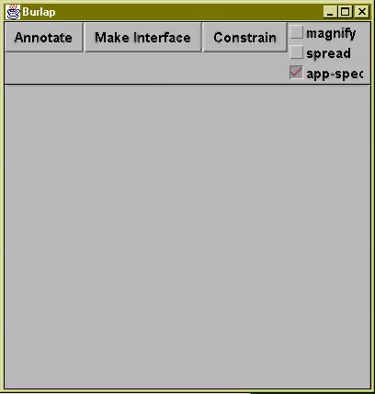
Example: Showing tentative Results

Slide 22
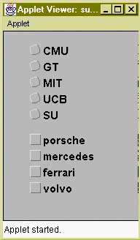
Freshness
Avoid repeating utterances, even when giving an instruction nearly identical to a previous one.

Slide 23
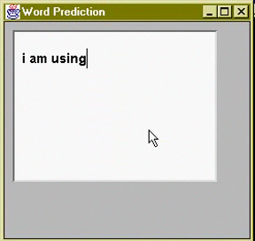
Progressive Assistance
Provide “successively more informative error messages which consider the probable context of misunderstanding” [Yankelovich95].
23
Notes:
the next strategy is progressive assistance, a term taken from Yankelovich et al’s work on designing speech interfaces. For example, telling a user in an ActiveCapture scenario to “Scream louder” is much more useful than just telling them to “Scream Again”. In some cases the system might not be able to determine the exact cause for a problem, in which case progressive assistance may just be the computer’s admission that it can’t determine the problem, but still suggest possible causes to consider.

Slide 24
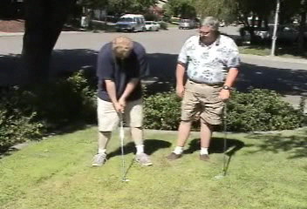
Method Shifts
In response to problems, vary forms of direction between Tell, Show, and Make.
Notes:
Direction can varying from giving instructions or TELLing the subject what to do, providing a demonstration or SHOWing the subject what to do, and MAKEing the subject do something, either by physical manipulation or through stimulus-response.
In this clip, the gold instructor handles error by switching from giving Nathan instructions to demonstrating proper technique.

Slide 25

Modality Shifts
When a particular direction approach repeatedly fails, switch or augment the modalities of communication, e.g., use visual rather than auditory cues.
Notes:
You can use multiple modalities at once. For example, in the clip I showed earlier, the Aikido instructor both physically demonstrated a roll, but also talked about each step as he was doing it.

Slide 26
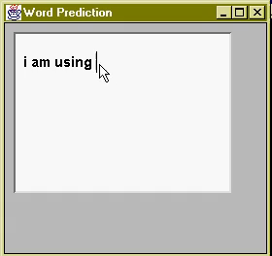
Shifting from writing to selection
Problem: The correct choice isn’t present
Example: word-prediction
Solution: Allow the user to add choices

Slide 27
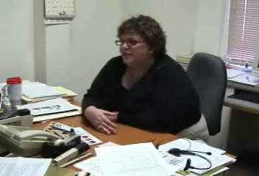
Level of Discourse
Simplify vocabulary and language when people have difficulty understanding.
Notes:
In this clip, the triage nurse describes how she changed level of discourse with a caller while discussing a child’s runny nose.

Slide 28
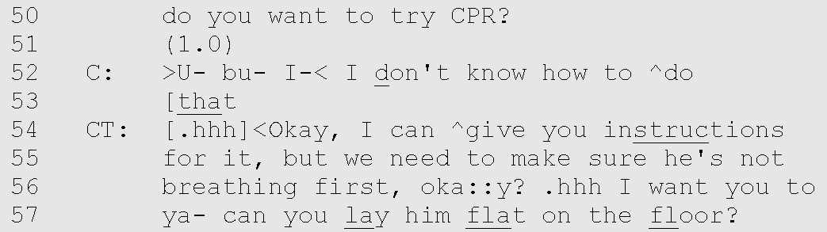
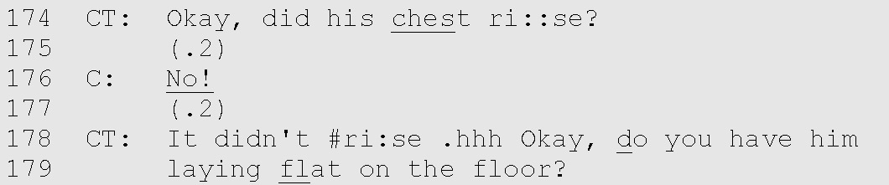
Backtracking
When grounding is lost, backtrack to the last state of mutual understanding.
Notes:
Mention tie to confirmation.

Slide 29
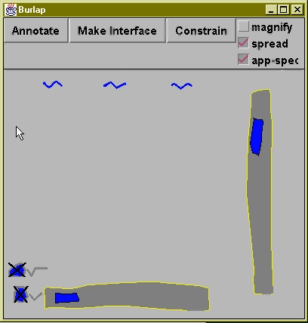
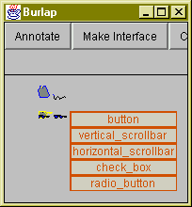
Example: Repetition

Slide 30
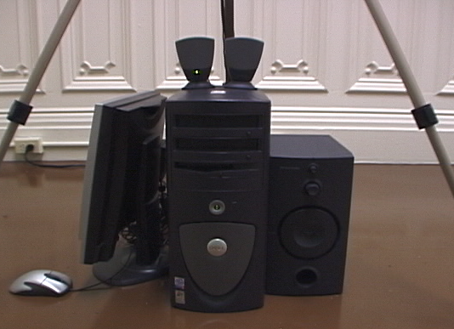
Graceful Failure
When all else fails, provide natural exits from the interaction.
JUMP!
Notes:
The heart of graceful failure is to recognize over-repetition and handle it accordingly. The problem may be that the user is not meeting programmed requirements, the system is malfunctioning, or there is some important context the system can not capture.
For example, an ActiveCapture scenario which instructs people to jump may be largely unsuccessful with injured or disabled users. The system design must recognize this possibility, by providing natural exits in the face of repeated failure.

Slide 31
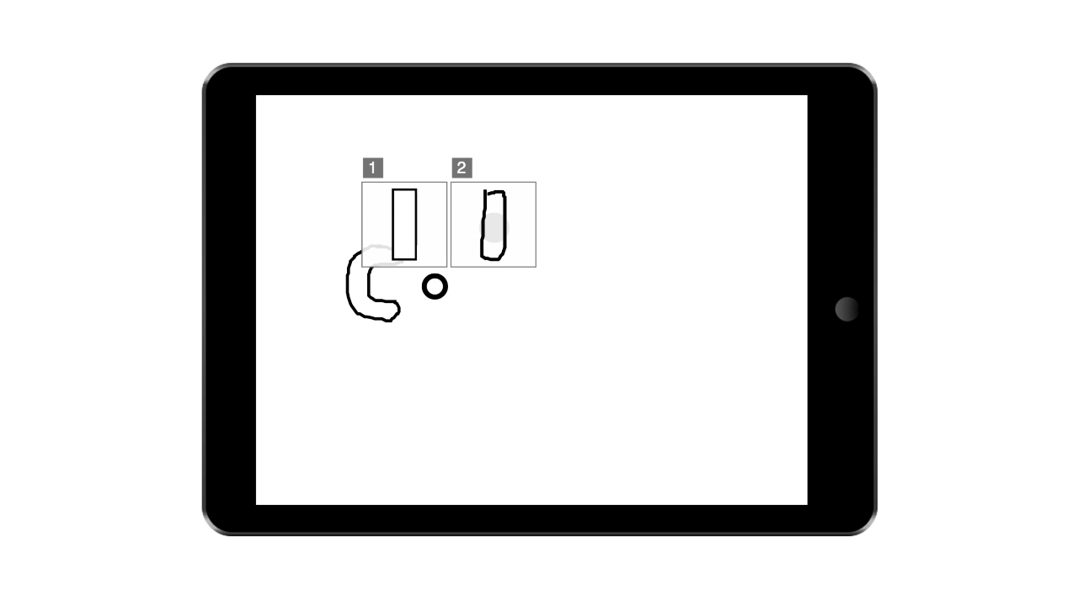
Video Demonstrations

Slide 32
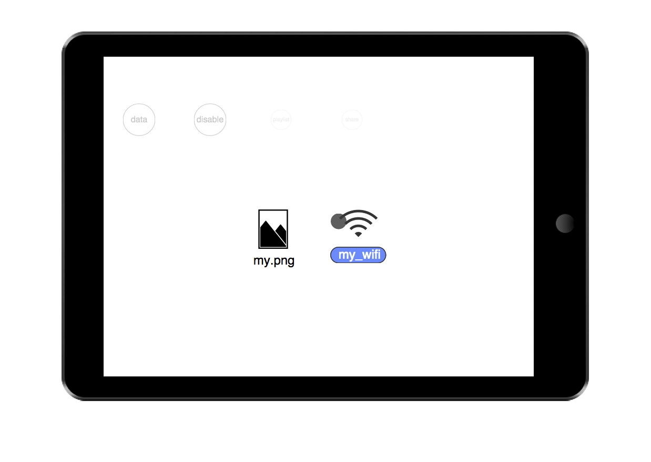
Notes:
In this application we can drag icons to targets to perform different actions on them.
The probabilistic version of this interface attempts to guess which action is going to be performed and adjust likelihood accordingly.
Here we adjust the scale of the targets according to likelihood, while adjusting opacity of icons.
This shows off another feature we have, which is that we can configure which feedback techniques to apply to which interactors by wrapping feedback into a meta-feedback object which changes what feedback to use based on interactor id, context, etc.

Slide 33
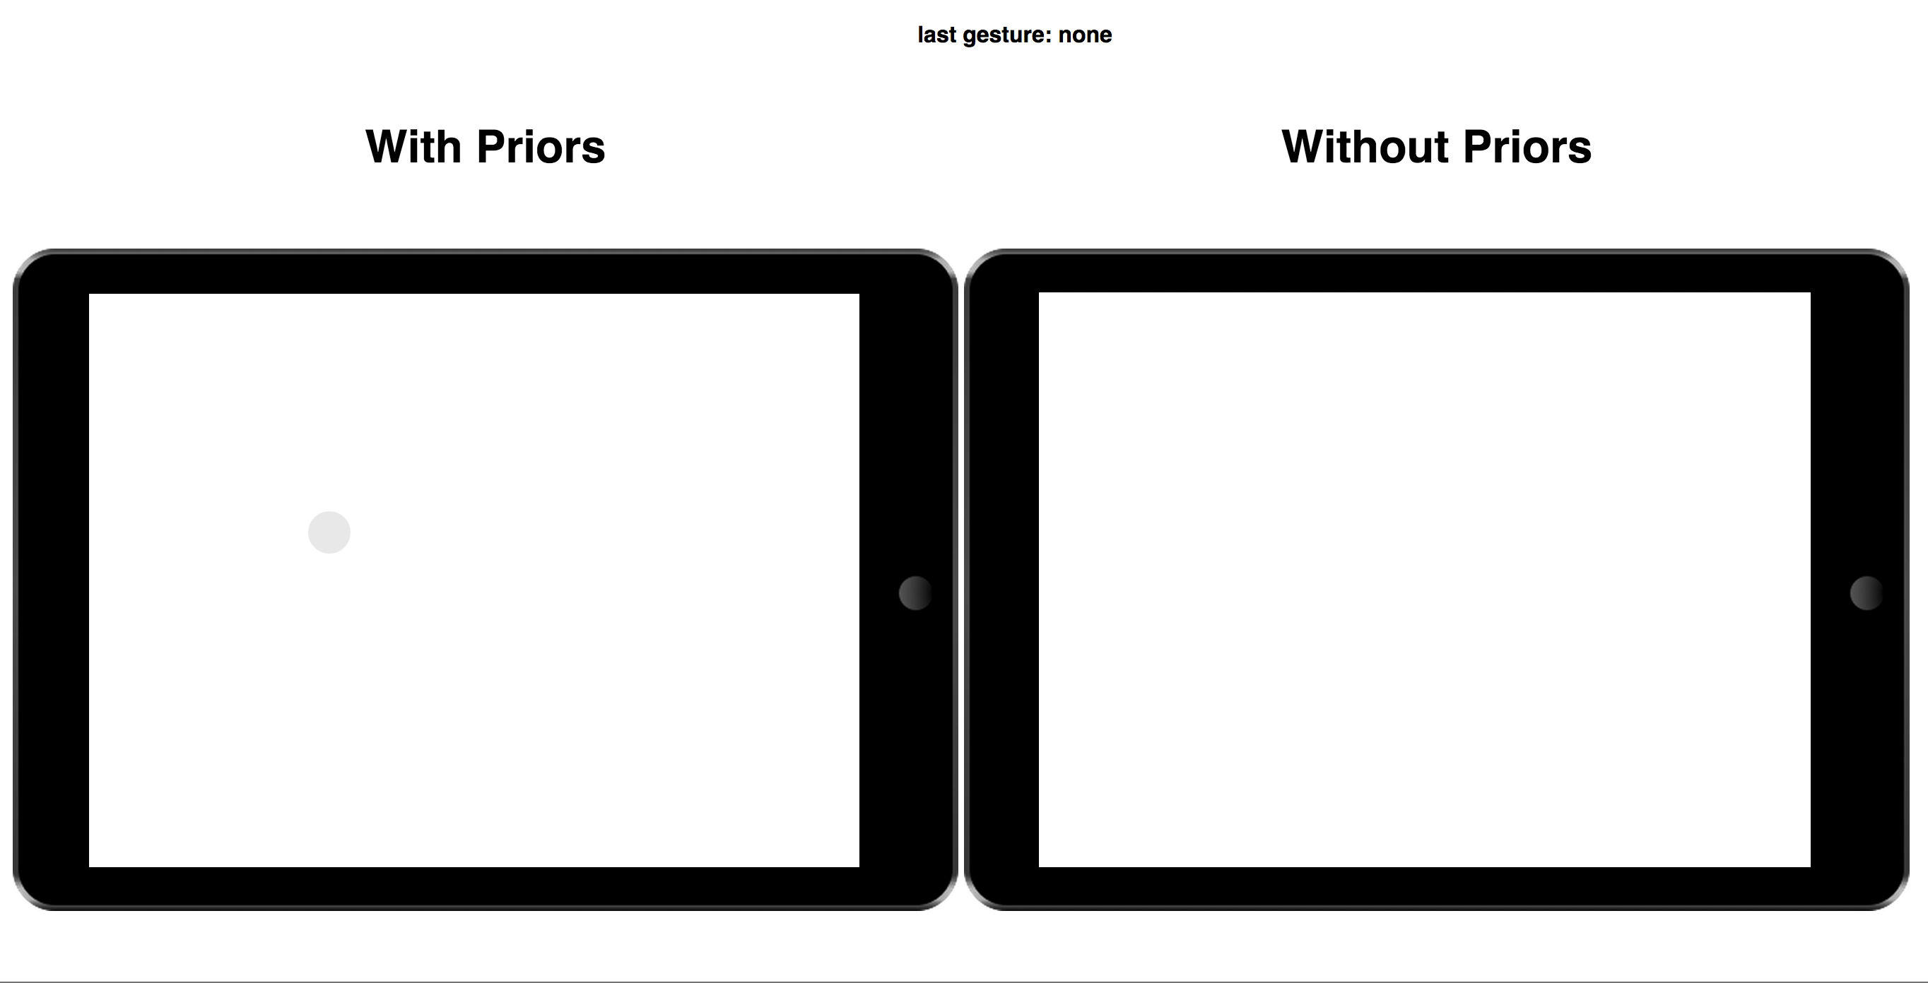

Slide 34
Usable Machine Learning
Difficulties with machine learning
Understand what is going on
Control what is going on
Potential cost to user
Corrections
Features
[Labels]
Notes:
xx add a summary slide for previous section of talk and think about talking through examples of web based systems.

Slide 35
Costly features at prediction time
Essence of the problem:
Have limited information on a new test point
Can acquire additional information, but at cost
Different features have different costs
Other examples
Choosing which tests to conduct to make a medical diagnosis
Giving personalized recommendations
Adaptive online surveys
Notes:
Main research result of this work is question ordering on a new test point—we focus on the application to personalized energy estimates, but there are other problems it can be used for too.
Feature cost relates to how likely a person is to answer a question—could be difficulty of answering, but could also be how willing a person is to disclose information (e.g., less willing to give sensitive information like SSN or home address, even if it’s easy to answer) / cost of answering (in the medical test setting)

Slide 36
RECS: Data collection
Contracted by the EIA
Household survey
Energy supplier surveys
Sample selection: multi-stage area probability sampling
Sample size = 18,856, ~15,300 were eligible
Responses = 12,083
Notes:
Multi-stage area probability sampling:
Divide U.S. into geographic domains (29 in 2009) [states and groups of states]
Randomly choose counties (primary sampling units)
Subdivide counties into Census blocks—segments
Randomly draw a sample of segments from the selected counties
Create sample frame (list of housing units to be surveyed) from combination of Delivery Sequence File (list of all addresses in U.S.) and field listing (for P.O. boxes, etc.)
Randomly select final sample of housing units from the list of housing units (sampling frame)
Of the 18,856 households sampled, ~15,300 were eligible (primary residences occupied in 2009)
Nearly all the responses were complete

Slide 37
RECS: Household Survey
Trained interviewers conduct interviews in person; average length = 51 minutes
Used hot-deck imputation to fill in missing values
Only 0.55% of values overall imputed
Varies by feature
Year built imputed 14.91%
Total square footage imputed 9.75%
Race imputed 7.44%
Notes:
Computer-assisted personal interview (CAPI)
Hot-deck imputation = fill in unknown variable with value from a ‘similar’ unit

Slide 38
RECS: Energy Supplier Survey
Mostly web-based; some respondents printed and mailed forms
90% response rate
Monthly consumptions and costs for electricity and natural gas
By-delivery reports for propane, fuel oil, etc.
Annual amounts reported in RECS
Notes:
Households provide sample energy bills, but they’re not used for household energy consumption. The Energy Supplier Survey gets consumption information from the suppliers.
ESS had online forms, structured spreadsheet, paper forms by mail
Bulk fuel suppliers gave info by delivery

Slide 39
Feature cost reflects how difficult it is to acquire a value for a feature.
Cost | Meaning | Example feature from RECS
0 | Extractable from listing | Number of bedrooms
1 | User probably already knows | If someone stays home during the day
2 | Might have to check current home | Size of TV
3 | Could maybe find in rental listing, or call for easy answer | Washing machine in home
4 | Look up online | Year housing unit was built
5 | Easily visible during visit | High ceilings
6 | Requires more effort to find out during visit | Type of glass in windows
7 | Requires visit + looking something up | Age of heating equipment
Notes:
Big jump from 4 to 5—costs<5 can be answered from the comfort of your current home. Costs 5+ require a site visit to the apartment.
Not always easy to assign cost to features—depends on the exact home/listing. E.g., if a listing had pictures of the kitchen, a user could see the door arrangement of the refrigerator (cost 3). If there were no pictures, then that would be an easily-visible feature (cost 5).

Slide 40
Free features can be automatically extracted from rental advertisements.
Feature | Presence in Rent Jungle database
Number of bedrooms | 85%
Number of full bathrooms | 57%
Studio apartment | 85%
City or zip code | 99%
State | 100%
Notes:
Free = cost 0
Rent Jungle is an online rental search engine that crawls the web for internet listings—they end up getting ~90% of all rentals listed online, which is ~80% of all rentals.
Geographic features are things like
Heating degree days
Cooling degree days
Climate zone
Urban/rural

Slide 41
Different cost levels of features provide different prediction performances.
The fraction of variance captured by a regression model trained on various sets of RECS features. Values closer to one indicate better performance.
Notes:
We used separate regression models for prediction of electricity and natural gas consumption.
Confidence intervals from repeating 50x
Clearly we can do v well if we use all 460 features.
…but how can we leverage a reasonable number of higher-cost features to make good predictions. How many extra high-cost features are needed in practice?

Slide 42

Let’s go through an example of DQO to make a prediction for natural gas use.
What we know:
What we can ask for:
2 bedrooms (NBE)
Number of household members (NHM)
Water heater size (WHS)
Age of heating system (AHS)
NBE
NHM
WHS
AHS
2
?
?
?

Slide 43
First, we estimate values for unknown features with kNN.
Find the k=5 homes nearest this one in the training set.
Known: 2 bedrooms

Slide 44



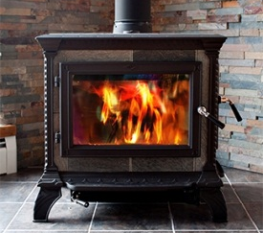
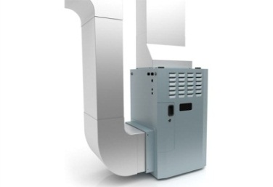
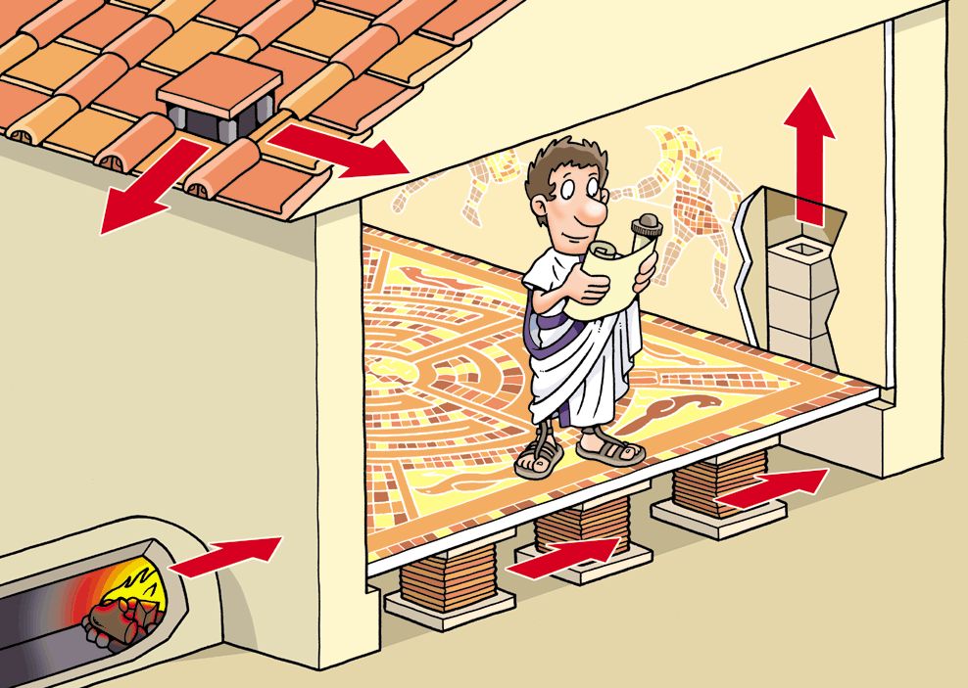
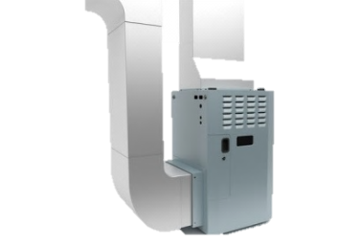
We look at the values for other features in the NNs to predict for the test point.
Unknown: number of household members, water heater size, age of heating system
Notes:
Households can have 1-4 people
Water heater size can be small (one drop), medium (two drops), or large (three drops).
Heating system can be relatively new (modern furnace), kind of old (wood stove), or ancient (hypocaust).

Slide 45

We look at the values for other features in the NNs to predict for the test point.
Unknown: number of household members, water heater size, age of heating system

Slide 46
We look at the values for other features in the NNs to predict for the test point.
Unknown: number of household members, water heater size, age of heating system

Slide 47
We look at the values for other features in the NNs to predict for the test point.
Unknown: number of household members, water heater size, age of heating system

Slide 48
Here is our filled-in feature vector z.
NBE | NHM | WHS | AHS
2 | 3 | 2 | 1
Notes:
Pink = imputed
3 household members
Medium-sized water heater
New heating system (age <2 years)

Slide 49

We can give the user an estimate now.
Your monthly gas bill will be between $37.37 and $40.72.
Cool!
Notes:
90% prediction interval

Slide 50
We can also ask for more information.
Now we’ll calculate expected prediction interval widths for including each potential feature to decide which to ask next.
Notes:
Use dynamic question ordering process to choose best feature to ask for next.

Slide 51
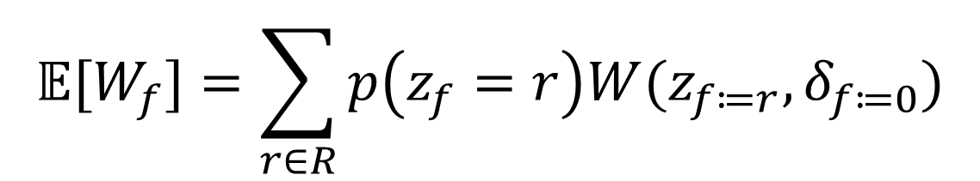
Calculate the expected prediction interval width for including each unknown feature.
$$𝔼[W_{f}]=\sum_{r∈R}{p\left(z_{f}=r\right)W(z_{f≔r},δ_{f≔0})}$$
Notes:
Recall prediction interval width W depends both on feature values in z and on feature error in delta.
To calculate the expected prediction interval width for the f-th feature, cycle through all values a feature can take on and taking a weighted average of the W values—set f-th feature to value r and f-th uncertainty to 0.

Slide 52
Calculate the expected prediction interval width for including each unknown feature.
Possible values
Feature
Expected pred.
Feature
Prevalence in training
set
δ
error (
)
interval width
Number of
1
2
3
4
1.77
household members
0.6
0.1
0.1
0.2
0.5
Small
Medium
Large
1.78
Water heater size
0.3
0.1
0.7
0.2
Age of heating
New
Old
Ancient
1.67
system
0.4
0.6
0.3
0.1
Notes:
Recall prediction interval width W depends both on feature values in z and on feature error in delta.
To calculate the expected prediction interval width for the f-th feature, cycle through all values a feature can take on and taking a weighted average of the W values—set f-th feature to value r and f-th uncertainty to 0.

Slide 53
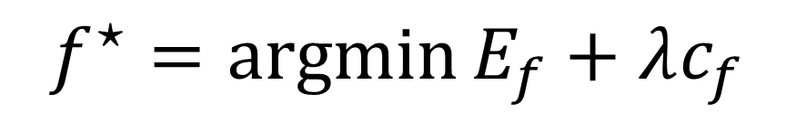
Penalize the expected prediction interval widths by the feature costs.
E
+
λ
c
Feature
Cost
E
f
f
f
λ
(
= 0.1)
Number of
1
1.77
1.87
household members
Size
of water heater
6
1.78
2.38
Age of heating
7
1.67
2.37
equipment
$$f^{⋆}=\operatorname{argmin}{E_{f}+λc_{f}}$$
Notes:
1—probably already know
6—requires more effort to find out during visit (e.g., going down to basement to look at water heater)
7—requires visit + looking something up: finding model number on heating equipment and looking it up online to see when it was manufactured
Even though age of heating equipment would give the (expected) most certain next prediction, it’s not worth it because of its high cost—ask for number of household members.

Slide 54

Ask for the optimal feature $f^{⋆}$, the number of household members.
How many people will live in this home?
2

Slide 55
Repeat…
Now we know:
And can ask for:
2 bedrooms
2 occupants
Water heater size
Age of heating system
NBE
NHM
WHS
AHS
2
2
?
?

Slide 56



First, we estimate values for unknown features with kNN.
Find the k=5 homes nearest this one in the training set.
Known: 2 bedrooms, 2 occupants
Notes:
Now we can also use number of occupants in the space for finding the k nearest neighbors.
Turns out we get the same 5 homes as last time, but it’s possible to get a new set of NNs.

Slide 57

And so on…
Your monthly gas bill will be between $35.32 and $38.59.
Even cooler!
What size is the water heater?

Slide 58
DQO results in more certain predictions than the baseline orderings.
The widths of 90% prediction intervals for electricity prediction, as questions are asked. Lower values mean more certain predictions.
Notes:
Particularly notable in first 5-15 questions—likely scenario that arises when users do not answer all questions.
Narrower prediction interval == more certain prediction
DQO results statistically different from baselines at 5% level.

Slide 59
The tradeoff parameter λ influences when expensive features are included.
Progressive total cost of all features provided, as questions are asked.

Slide 60
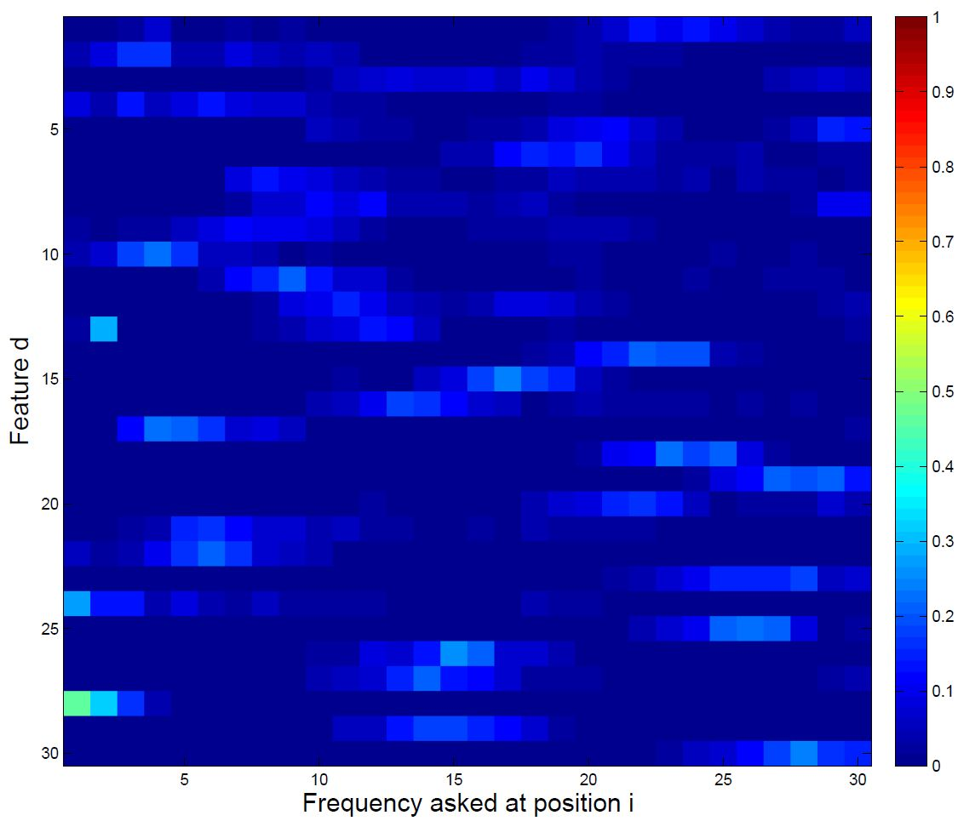
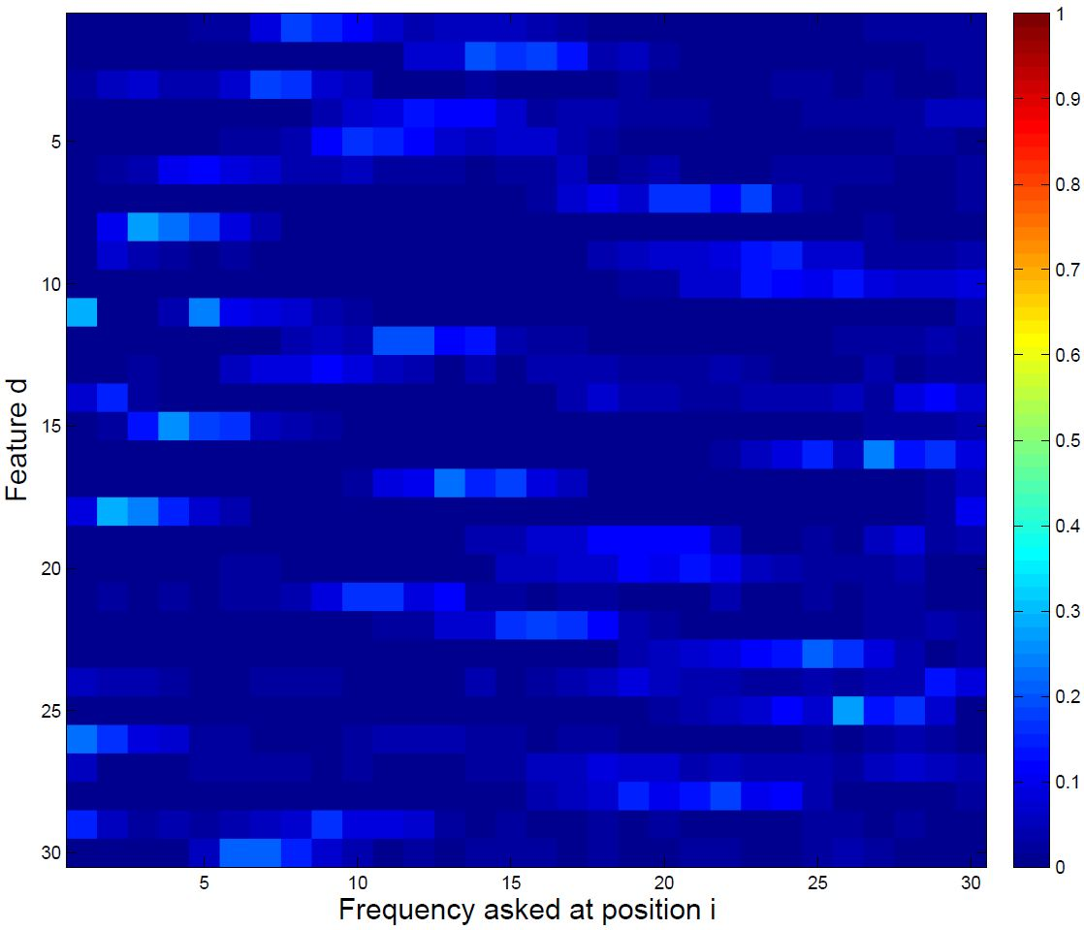
The oracle chooses features to add fairly uniformly, across test samples.
Electricity
Natural gas
Notes:
Indicates there is no single best order to ask questions across all households, which is why DQO is valuable

Slide 61
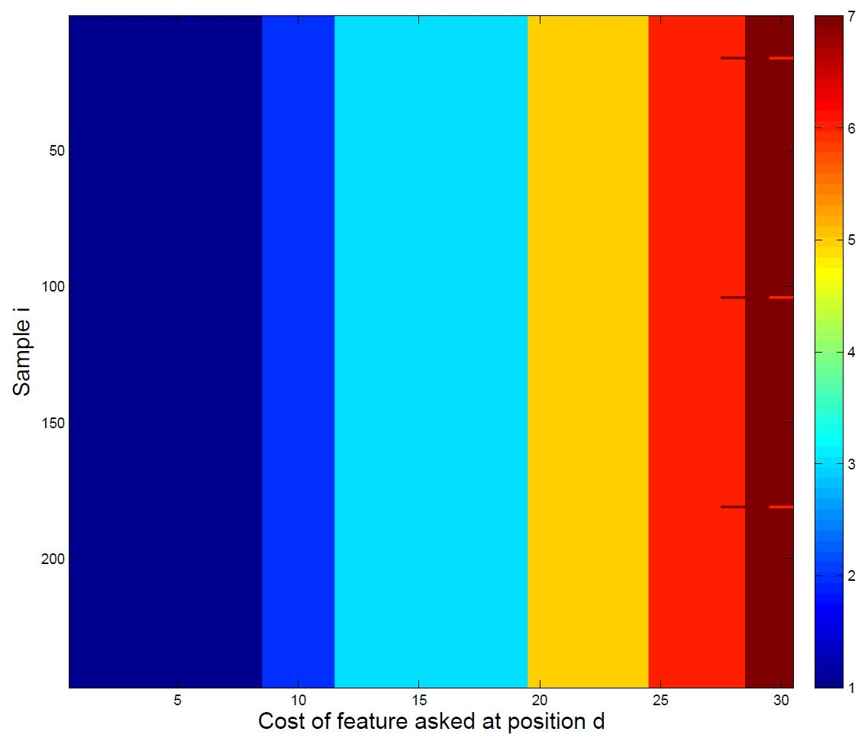
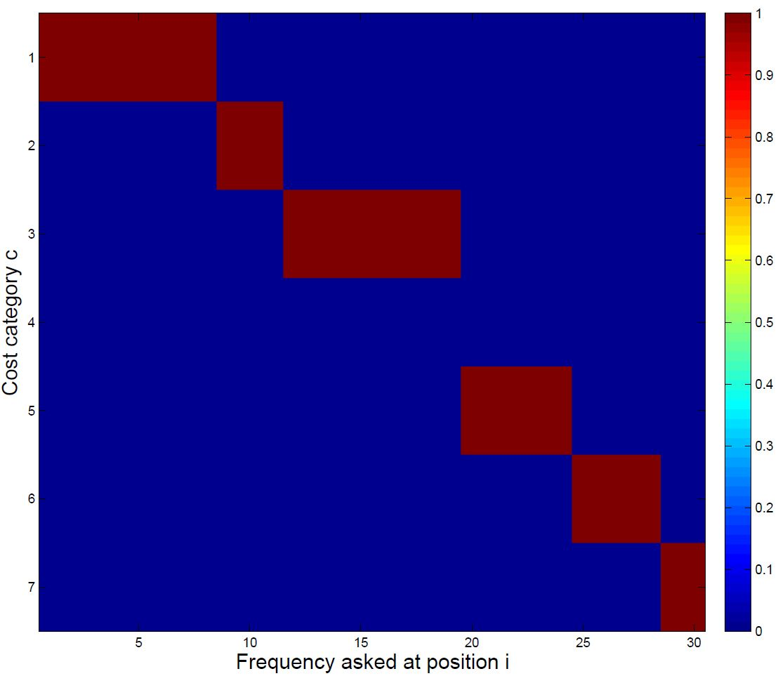
λ = 0.01
Cost of features asked in each position for all test samples.
Frequency each cost category 1-7 was asked in each position.

Slide 62
EDigs helps prospective tenants in the rental search process.
Provides users with personalized estimates for utility costs.
If you’re looking for an apartment in Pittsburgh…edigs.org
Also an Android and iPhone app
Notes:
Other features: associate pictures and notes with homes; share notes; filter search by price, size, etc.; include walkscore for homes; ratings for homes; upcoming: city data about building violations

Slide 63
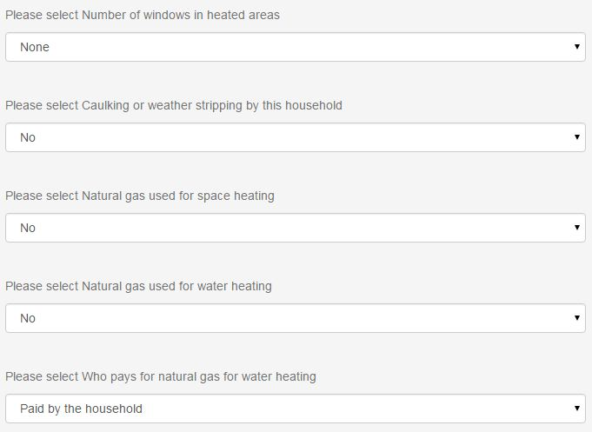
EDigs users can provide more information about a unit or themselves.
Notes:
DQO not yet implemented on website

